Slide 1

Project Overview
Title: Sales Pro Software Business Growth Analysis
Overview: This Power BI project provides insights into total revenue, units sold, customer segmentation, and regional performance to help drive business decisions

Slide 2

Key Metrics and Dimensions
Metrics Covered:
Total Revenue
Total Units Sold
Average Revenue
Discounted Sales
CSAT (Customer Satisfaction)
Dimensions:
Customer Segments: Enterprise & Small Business
Regions: Asia, Australia, Europe, North America

Slide 3
Total Revenue & Units Sold
Example Data:
Total Revenue: 54.40M (North Region)
Total Units Sold: 51K (North Region)
Purpose:
Track overall sales performance and unit sales
across regions.

Slide 4
Average Revenue & Discounted Sales
Example Data:
Average Revenue: 54.40K (All Region)
Discounted Sales: 12.47M (All Region)
Total Revenue : 54.40M (All Region)
Total Unit Sold : 51k (All Region)
Purpose:
Understand revenue per sale and the impact of discounts on total sales.

Slide 5
Customer Segmentation
Segmentation Breakdown:
Enterprise vs. Small Business customers
Example:
Enterprise 27K units, Small Business 15M revenue
Purpose:
Tailor strategies based on customer segment performance.

Slide 6
Region Analysis
Regions Covered:
Asia, Australia, Europe, North America
Example Data:
Revenue by region and regional contribution (e.g., 100% revenue for Q2)

Slide 7
CSAT (Customer Satisfaction)
Example Data:
CSAT Scores: 0.00 in one month, 4.01 in Overall months out of 5.
Purpose:
Correlate customer satisfaction with revenue and identify areas for improvement.

Slide 8
Monthly Sales Data
Example:
February: 24K Revenue (47.14% increase from previous period)
Units Sold Based on Customer Segment
Purpose:
Evaluate sales trends and unit sales across time.

Slide 9
Revenue by Day
Example Data:
Revenue Generated by Day: 24K
Change: 47.14% increase
Purpose:
Monitor daily sales fluctuations and trends.

Slide 10
Sales Channel Analysis
Example:
Revenue generated via the Online Sales Channel
Purpose: Assess channel performance to optimize sales strategy.

Slide 11
Quarterly Revenue by Region
Example Data:
Breakdown of quarterly revenue across Asia, Australia, Europe, North America
100% revenue contribution from all regions
Purpose: Analyze region-specific performance for future planning.

Slide 12
Data Model Overview
Tables Involved:
Sales Data
Customer Data (Enterprise & Small Business)
Region Data (Asia, Australia, etc.)
CSAT Data
Sales Channel Data
Purpose: Provide the structure of how data is organized and analyzed.

Slide 13
Visualizations in Power BI
Types of Visuals:
Bar/Column Charts
Line Charts
Pie Charts
Tables
KPI Indicators
Slicers
Purpose: Show data through interactive visuals for insights.

Slide 14
Business Insights
Revenue & Sales Trends:
Identify growth areas and optimize strategies.
Regional Performance:
Focus on regions with lower sales.
Customer Segmentation:
Focus marketing efforts on high-value segments.
.
Discount Analysis:
Understand the effect of
promotions.
CSAT:
Correlate satisfaction with performance

Slide 15
Conclusion
Summary:
The Power BI dashboard provides real-time insights into business performance, enabling data-driven decisions.
Key Recommendations:
Target underperforming regions
Evaluate discount effectiveness
Monitor CSAT trends for improvement

Slide 16
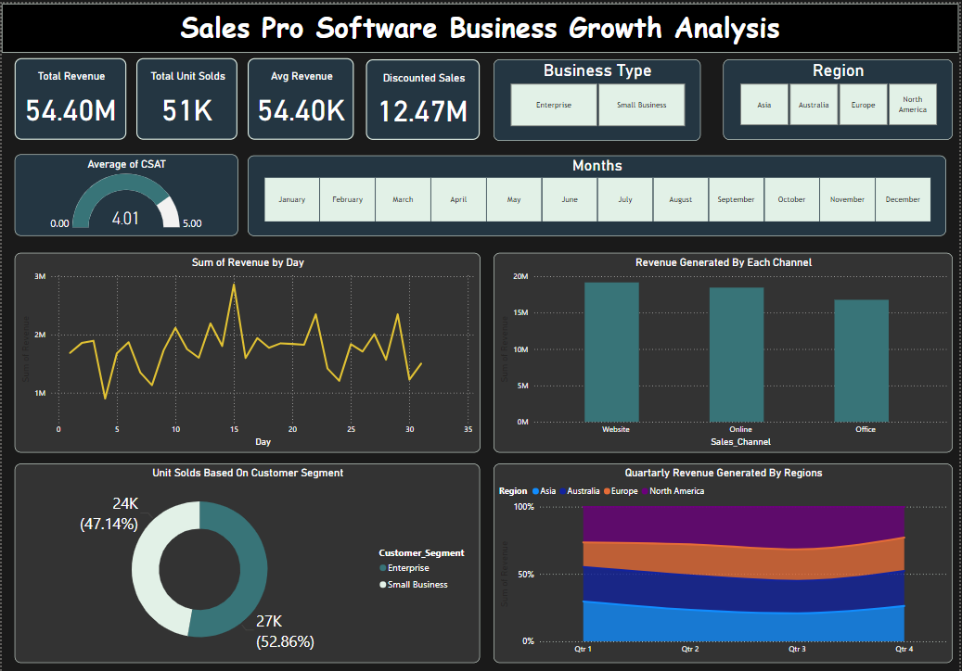
Project dashboard And Screenshots

Slide 17
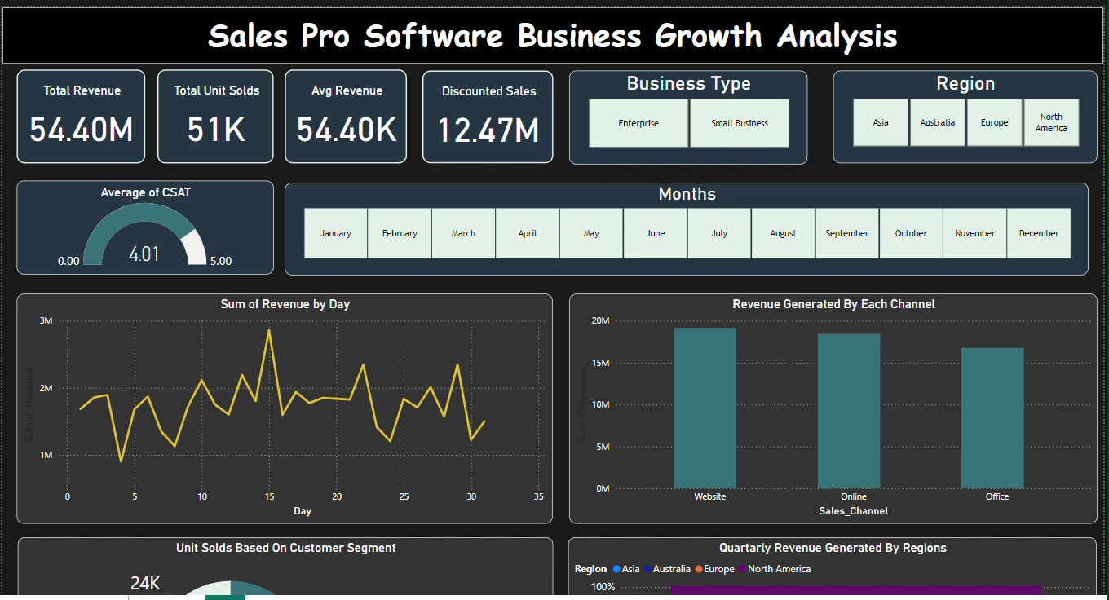
Project Dashboard Video

Slide 18
Thank You
Projected By – Dipak Gaikwad

